Slide 1



Weekly report: Machine Bed & Yaw System
Week # 2
Date: 07/10/2025
Supervisor: Prof. Quell Peter
Group members: Shoukat Abbas, Luksh Chawla, Sathishkumar Venkatachalam, Shrihari Kadam
Flensburg University of Applied Sciences

Slide 2
Contents
Reference Models For Bed plate - 5MW with 4-point support
Reference Models For Bed plate - 5MW with Separated Bed plate
Reference Models from Optimus Sakthi
Coordinate system & load definitions (IEC)
Axial Load and Radial load Comparison
About NGC Group
Reference
Shoukat Abbas, Luksh Chawla, Sathishkumar Venkatachalam, Shrihari Kadam

Slide 3
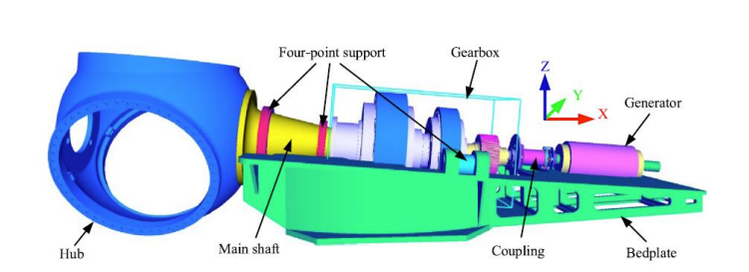
Reference Models For Bed plate - 5MW with 4 point support
Credits: Norwegian University of Science and Technology - Dr. Jason Jonkman, Prof. Erin Bachynski-polic Source: [2]
Shoukat Abbas, Luksh Chawla, Sathishkumar Venkatachalam, Shrihari Kadam

Slide 4
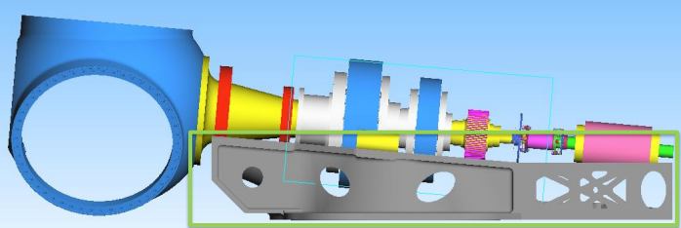
Reference Models For Bed plate - 5MW with 4 point support
1. Models are Same, Changes in Design
2. Design Changes in Tail Area, Addition of casting material.
3. Ribs and Cost cuttings are Added - For stability and reduction of Material Weight & cost.
Shoukat Abbas, Luksh Chawla, Sathishkumar Venkatachalam, Shrihari Kadam

Slide 5
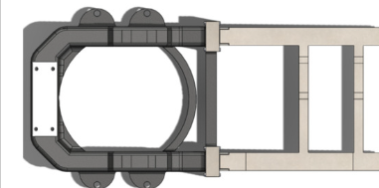
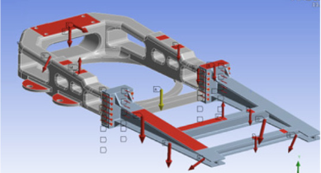
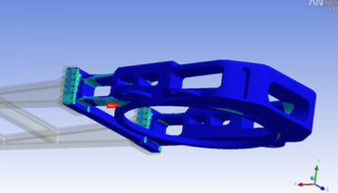
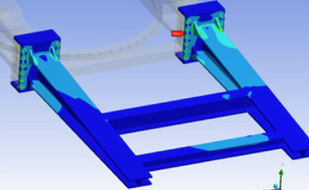
Reference Models For Bed plate - 5MW with Seperated Bed plate
Source : https://www.mdpi.com/1996-1073/14/12/3581?utm_source [3]
Shoukat Abbas, Luksh Chawla, Sathishkumar Venkatachalam, Shrihari Kadam

Slide 6
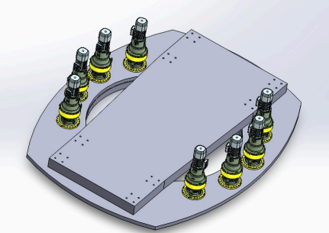
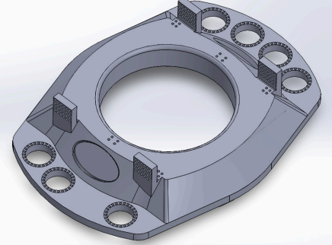
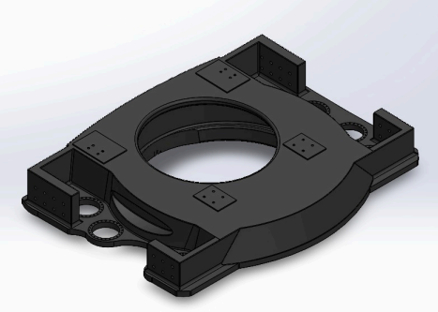
Reference Models from Optimus Sakthi
Shoukat Abbas, Luksh Chawla, Sathishkumar Venkatachalam, Shrihari Kadam

Slide 7
For Optimus Syria - What do we decide at the moment to go for in Design?
Bed type:
Go for Casting
Material:
Grey Cast Iron (EN-GJL-250 (GG25)
Price as per market - 2.8 to 3.2 Euro / Kg
Max. Weight of a Machine Bed:
15 to 22 tons ( For 5MW turbine)
Single frame Design, may be changed into separate in the future (If needed)
Shoukat Abbas, Luksh Chawla, Sathishkumar Venkatachalam, Shrihari Kadam

Slide 8
Coordinate system & load definitions (IEC)
Blade-root coordinates:
X = Thrust (along shaft)
Y = vertical radial / flapwise (along y)
Z = lateral / side to side (along z)
Hub / Nacelle coordinates:
Fx = axial force, Mx is rotor torque moment (about x)
Fy = radial (vertical), My = tilting moment (about y)
Fz = lateral force, Mz = yaw moment (about z)
Fig: Global blade coordinate system [1]
8

Slide 9
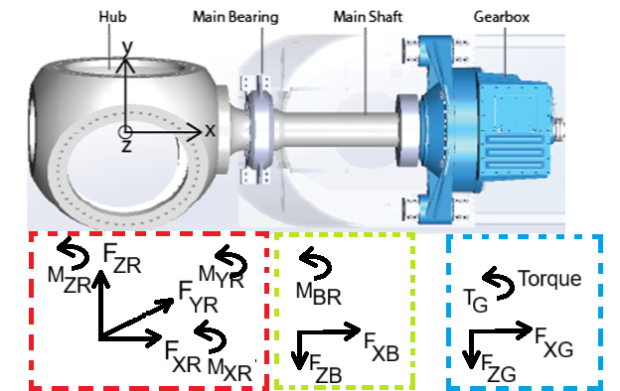
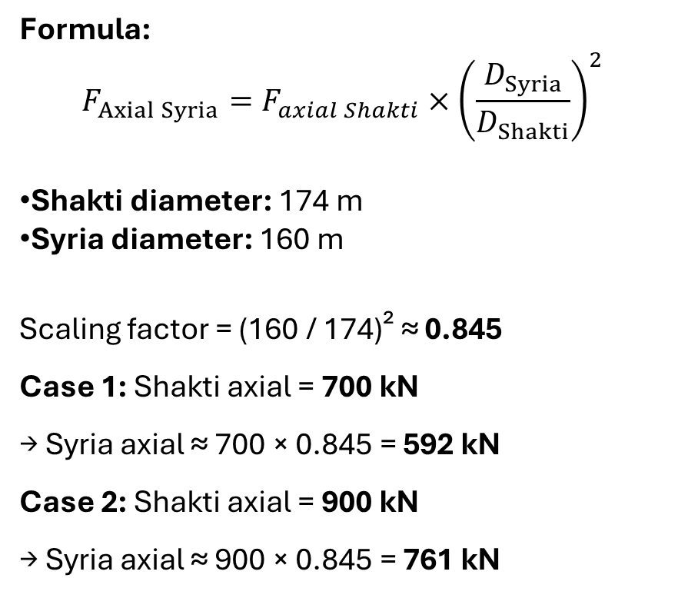
Axial Load and Radial load Comparison
Formula:
$$F_{Axial Syria}=F_{axial Shakti}×{\left(\frac{D_{Syria}}{D_{Shakti}}\right)}^{2}$$
Shakti diameter: 174 m
Syria diameter: 160 m
Scaling factor = (160 / 174)² ≈ 0.845
Case 1: Shakti axial = 700 kN → Syria axial ≈ 700 × 0.845 = 592 kN
Case 2: Shakti axial = 900 kN → Syria axial ≈ 900 × 0.845 = 761 kN
Case 1: Shakti radial = 800 kN → Syria radial ≈ 800 × 0.845 = 676 kN
Case 2: Shakti lateral = 2000 kN → Syria lateral ≈ 2000 × 0.845 = 1690 kN
9

Slide 10

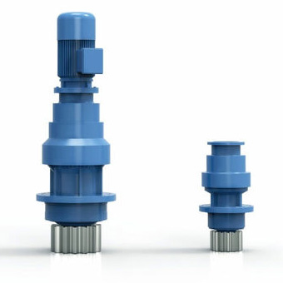
Nanjing High Accurate Drive Equipment Mfg Group Co., Ltd. (NGC Group)
Multi-megawatt pitch gearboxes and yaw drives wind turbines.
With more than 20 years of experience in the wind energy field
Product Features
Torque: 10 kNm - 250 kNm
Wind turbine power: 1x MW - 15 MW
High bearing capacity
High reliability and efficiency
Compact design
Applications
Onshore & offshore
Low & high-altitude areas (> 1000 m)
Low & high temperature environments (-40 °C to + 50 °C)
Low wind speeds
10

Slide 11
References
[1] P. N. Castelos, “On the impact of multi-axial stress states on trailing edge bondlines in wind turbine rotor blades,” https://www.researchgate.net, Oct. 2016. https://www.researchgate.net/publication/308793459_On_the_impact_of_multi-axial_stress_states_on_trailing_edge_bondlines_in_wind_turbine_rotor_blades
[2] V. Liverud, J. Jonkman, and Bachynski-Polić, “Drivetrain structural flexibility in OpenFAST.” Accessed: Oct. 06, 2025. [Online]. Available: https://www.sintef.no/globalassets/project/eera-deepwind-2023/presentasjoner/substructures_krathe.pdf?utm_source
[3] A. S. Pehlivan, M. F. Aksit, and K. Erbatur, “Fatigue Analysis Design Approach, Manufacturing and Implementation of a 500 kW Wind Turbine Main Load Frame,” Energies, vol. 14, no. 12, p. 3581, Jun. 2021, doi: https://doi.org/10.3390/en14123581.
11

